Slide 1
The TRADOC G-2 Ontologies
TRADOC G-2 Data-Centric Vision:
‘Provide the right information, to the right person, at the right time, in the right format.’
8 August 2019

Slide 2
Background: What are ontologies?
An ontology is a way to organize and store information through classes, properties, and instances
They use three place relations, with the Subject-Predicate-Object structure ( Think “Noun Verb Noun”, or “Car is a Vehicle”). These are referred to as triples
With this format, we are able to organize the world (We’ll start with the Operational Environment and go from there) by taking data and adding structure to it
The power is in the connectivity. By linking data together through relations, we gain the ability to discover more connections and relations through inferencing

Slide 3
Background: Classes, Instances, and Properties
Class: Used to represent general concepts, for example, “Car” or “Tire”
A Subclass of this would be a more specific distinction, such as “Honda Accord” or “Goodyear Tire”
Instance: Used to represent the real world specifics of classes. . In this case, we can think of a specific Honda Accord, which we can refer to by unique identifier, such as the VIN Number. So “VX33532PD” would be an example of an instance of that class
Property: Used to connect classes and instances together. Classes and subclasses are connect through the is_a property, and other properties will further help describe classes and instances, such as “has_color”

Slide 4
Background: The value of ontologies
Inferencing- By having specific classes that are well defined and relations that connect them, more information becomes available. Running an inference engine across data in an ontology aligned structure will discover more relations and connections between classes and instances
Structured Data- Ontologies create more structure to data, which will help organize information for easy access and powerful querying
Common Vocabulary- By defining classes and properties, there is little ambiguity in what the data actually represents
Querying- Ontologies can be queried using SPARQL, a query language that allows for semantic searching

Slide 5
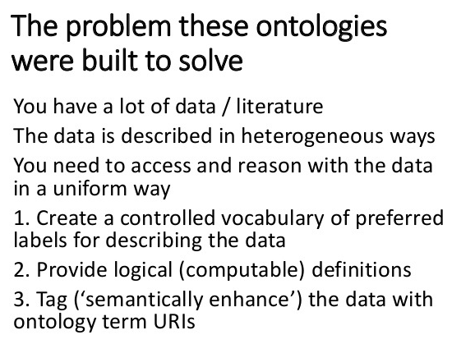
Big Picture
Taken from “Towards an Ontology of Philosophy” presentation given by Barry Smith
The issues of the operational environment and future warfare are ideal for this
How can we extract data from many sources, normalize it, and find value?
Notes:
The presentation was given to the APA, Vancouver, April 2, 2015
Addresses Siri: An Ontology-driven Application for the Masses
Breaking Defense, ArXive, Brookings, other sources

Slide 6
Background: Types of ontologies
Upper Level Ontologies: Meant to be small and capture high level abstract concepts (regions, objects, processes, temporal regions)
Mid Level Ontologies: Meant to contain terminology and concepts that will exist across many domains
Domain Ontologies: Highly specific to one area of knowledge

Slide 7
TRADOC Ontology Hierarchy
Basic Formal Ontology (BFO): This is used as the upper level ontology due to easy integration and wide acceptance in the biomedical and military domains
Common Core Ontologies (CCO): This is a collection of mid level ontologies that provide common terminology and relations that are well defined and applicable across many domains (Relations, Artifacts, Agents, etc.). They were created and are maintained by the BFO working group
TRADOC OE Ontologies: Created to capture the Operational Environment and the Changing Character of Future Warfare domain
Notes:
CCO contains Agent, Artifact, Currency Unit, Event, Extended Relation, Geospatial, Information Entity, Modal Relation, Quality, Relation, Time, Units of Measure

Slide 8
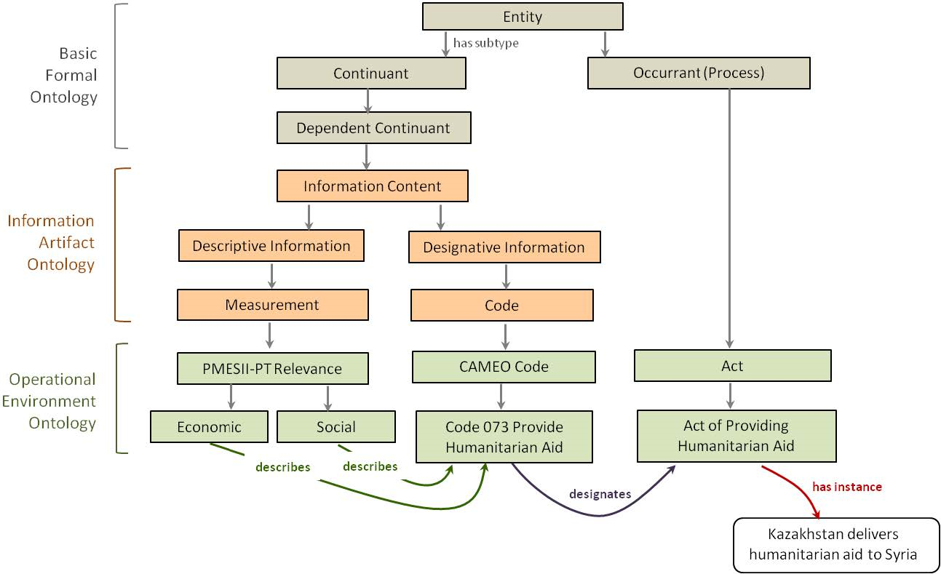
Putting It All Together

Slide 9
OE Ontologies
Analysis Framework Ontology: Contains PMESII-PT, DIMEFIL, and CCoFW classes, as well as controlled vocabularies used for topic generation
Army Hierarchy Ontology : Contains the group hierarchy in the Army, ranging from squad to brigade. to support Army Training data
Army Training Ontology : Contains properties associated with Army tasks
Ethnicity Ontology : Contains a list of ethnicities (Sourced from ICEWS)
Event Ontology : Contains a list of event types (Sourced from the CAMEO Event and Actor Codebook)
Ideology Ontology : Contains a list of political orientations and religious ideologies (Sourced from ICEWS)
Organization Ontology : Contains classification of groups (ex. Refugees, Rebels, Businesses)
Religion Ontology : Contains a list of religions as well as acts (act of confession, act of prayer, act of jihad)
Notes:
CCO contains Agent, Artifact, Currency Unit, Event, Extended Relation, Geospatial, Information Entity, Modal Relation, Quality, Relation, Time, Units of Measure
Analysis Framework- [ 871 classes, 24 properties]
Army Hierarchy- [ 32 classes, 0 properties]
Army Training- [ 26 classes, 206 properties]
Ethnicity- [ 377 classes, 0 properties]
Event- [ 584 classes, 2 properties]
Ideology- [ 45 classes, 1 property]
Organization- [ 24 classes, 0 properties]
Religion- [ 54 classes, 5 properties]

Slide 10
Controlled Vocabularies
Controlled vocabularies
This process involves looking for doctrinal sources or adopted standards
Since some of these trends are very new this process will involved a mix of accepted standards/doctrine as well as SME input and mining other sources
We are looking at how to mine key terms from the archived data set
Finding authoritative or accepted definitions will be harder.

Slide 11
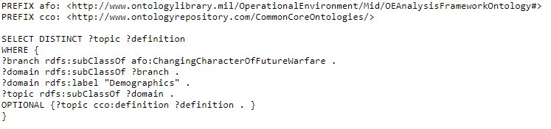
Querying and Output
The OE Ontologies are loaded into a cloud based triple store (Apache Rya) for web based search
Data can be accessed through SPARQL queries

Slide 12
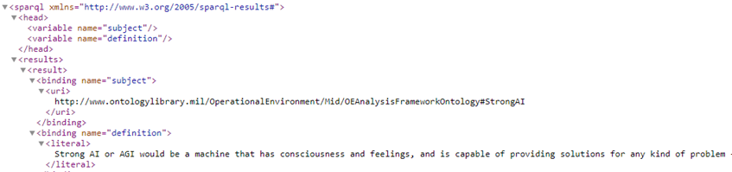
Querying and Output
Currently being used to load data for GEODE
Queries are ran and the data is passed back in either JSON or XML

Slide 13
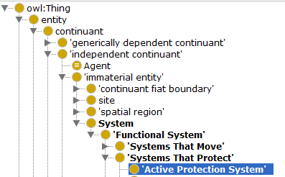
Why Multiple Vocabularies
Different Scope: PMESII-PT and DIMEFIL both address “economics”
For DIMEFIL, economics and finance are two different categories, In PMESII-PT, they are combined

Slide 14
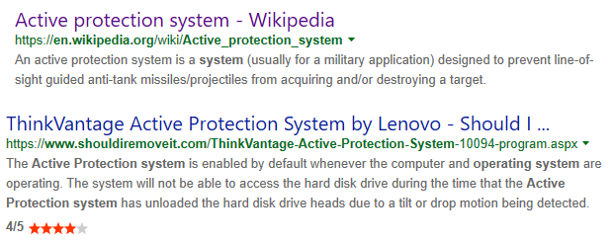
Why Multiple Vocabularies
By controlling the terminology contained in a vocabulary, we can greatly reduce the number of false positives

